Slide 1

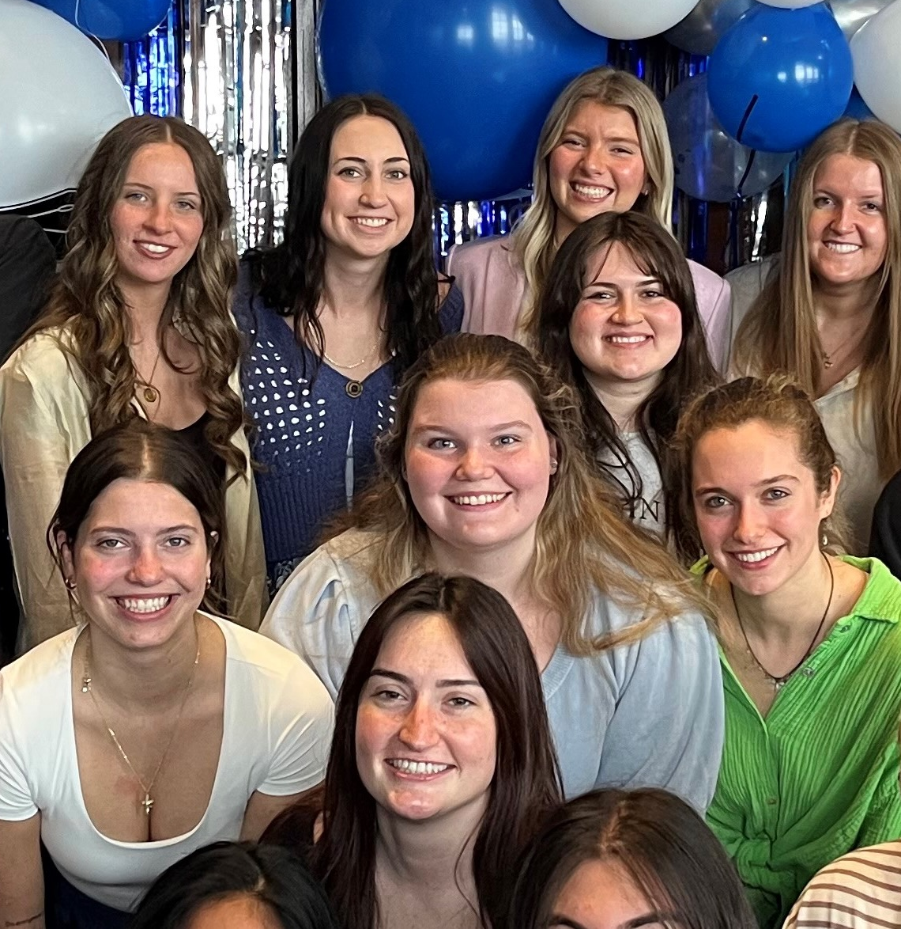
1. RECENT JOB/INTERNSHP OPENINGS | New week, new opportunities to learn and grow as an HTM professional. Check out the listings for jobs and internships!
2. GVSU TEACH-IN | The GVSU Teach-In: Lifelong Learning Toward Educational Equity and Action is a campus-wide opportunity that explores educational equity across disciplines. Join us November 10 on the Valley Campus and November 11 on the City Campus.
3 GRADUATE SCHOOL FAIR | Explore your future at the annual GVSU Graduate School Fair hosted by the GVSU Career Center on Wednesday, October 21, 2026, from 12pm - 2pm in the Henry Hall Atrium on the Allendale campus.
4. HTM SPEAKER SERIES | Real Talk: From Graduation to Getting Ahead November 4th 12:00 -1:00pm Taylor Smith is the Content Manager of Destinations at Meetings Today, Writer of National Award-Winning Column “The Z”, co-host of the Eventualists podcast, and names a 2024 Woman to Watch.
10.19.2026

Slide 2
New Internship and Employment Opportunities
Summer Manager Intern - Multiple Positions
Short's Brewing Co. - Elk Rapids, Michigan
Application Deadline: 1/12/27
Posted: 10/12/26
Wedding Coordinator Internship (Openings for all of Michigan!)
The Best Day Details - Grand Rapids, Michigan
Application Deadline: October 29th 2026
Posted: 10/12/26
Housekeeping Host
Hyatt Place Grand Rapids Downtown - Grand Rapids, Michigan
Application Deadline: 1/12/27
Posted: 10/12/26
Gallery Host
Hyatt Place Grand Rapids Downtown - Grand Rapids, Michigan
Application Deadline: 1/12/27
Posted: 10/12/26
1

Slide 3

GVSU TEACH-IN
The GVSU Teach-In: Lifelong Learning toward Educational Equity and Action is a campus-wide, student-centered learning experience dedicated to advancing educational equity across the university. Bringing together students, faculty, and staff, the Teach-In creates opportunities to explore how educational equity shapes teaching, learning, research, and practice across disciplines, including technology, healthcare, engineering, business, the arts, and beyond.
Join us November 10 on the Valley Campus and November 11 on the City Campus.
Faculty, staff, and students are invited to submit session proposals by October 11.
2

Slide 4

CAREER CENTER EVENTS
Graduate School Fair 2026
Wednesday, October 21, 2026
12:00 p.m. - 2:00 p.m.
Henry Hall Atrium
3
The GVSU Career Center is excited to welcome you and several representatives from universities and colleges across the nation to this amazing in-person event. This is a great opportunity for you to learn about their graduate programs and connect with educational professionals from renowned institutions.
To view the list of Graduate Schools, check out www.gvsu.edu/careers/gradfair26

Slide 5
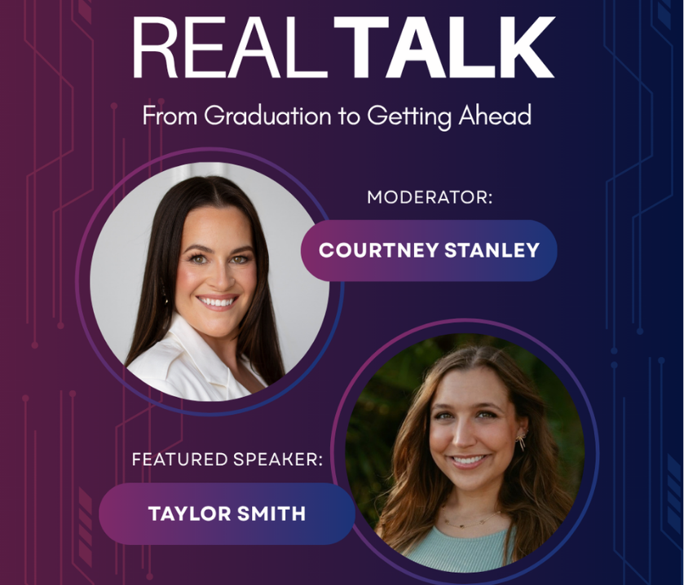
HTM SPEAKER SERIES
Wednesday, November 4, 2026
12:00 pm – 1:00 pm via Zoom
Registration required to obtain Zoom link
4
This virtual event will feature Taylor Smith, Content Manager, Destinations at Meetings Today, and will be hosted and moderated by Courtney Stanley, an accomplished industry professional and advocate for emerging hospitality leaders.
Taylor is a rising voice in the meetings, tourism, and hospitality industry who has made an impressive impact early in her career. She is the creator of the nationally award-winning column The Z, co-host of the Eventualists podcast, and has been recognized among EventEx's Most Influential People in 2024 and 2025. She was also named a 2024 Woman to Watch.

